Slide 1

Global Oil Trade
Shadow Hubs
Keerti Rawat · Muskan Khepar · Nikhil Kumar · Stiles Clements · Zan Merrill
Social Media & Network Analytics - Spring 2026

Slide 2
The Question
Billions of dollars in sanctioned oil still moves around the world every year. It doesn't vanish, it reroutes through intermediary countries that act as hidden middlemen in the trade network.
Use Network Analytics
1) Which countries are “shadow hub” (have more network centrality than their trade volume alone would predict)?
2) Which countries are the biggest “emergent” shadow hub over time?
3) How does sanctions exposure (high OFAC footprint) relate to shadow hubs?
4) For any shadow hub, who are it’s top trade partners in a given year?

Slide 3
Why It Matters
OFAC sanctions target entities (firms, vessels, individuals), not entire countries.
Oil trade doesn’t disappear, it reroutes.
Rerouting concentrates through a small set of intermediary countries (“shadow hubs”).
Finding these hubs gives investigators a prioritized shortlist for deeper OSINT / compliance review.
We use network structure to detect where sanctioned trade is most likely being intermediated.
Sanctioned Source
Shadow Hub
Destination

Slide 4
Data Sources
UN Comtrade
(Country level Trade)
OFAC SDN
(Sanctioned Entities)
→ Bilateral Trade Tables for
HS 2709 (Crude oil)
HS 2710 (Non-Crude Oil)
→ Yearly data from 2019-2024
→ 232 Countries with 45,513 directed trade edges
→ Trade Values in USD
→ 9,000+ Sanctioned Entities data
Individuals
Companies
Vessels
→ Latest Snapshot
→ 177 Countries signal from addresses
→ Aggregated counts by ISO3

Slide 5
Data Pipeline
Filter and Standardize Comtrade data by keeping only country-to-country flows with trade value and normalizing identifiers to ISO3 and cleaning unknowns
1
Construct network tables as an edges table (exporter_iso3 → importer_iso3, year, trade_value_usd) and a nodes table (unique country_iso3 + metadata)
2
Parse + map OFAC SDN by extracting each entity’s primary country, normalizing country text, and converting to ISO3 (overrides + pycountry) with coverage checks
3
Aggregate + merge OFAC by rolling entity-level OFAC into country-level counts (ofac_entities, ofac_entity_country_links) and left-joining onto the country nodes table
4
Compute per-year network metrics (betweenness, degrees, total trade volume) from the directed trade graph built from edges
5

Slide 6
Building the Network
We built directed weighted graphs for each year from 2019–2024 using UN Comtrade bilateral oil flows. 232 country nodes connected by 45,513 trade edges.
Nodes - Exporter/Importer
Weighted Edge
(Trade value in USD)
Calculate node metrics - betweenness centrality, in/out degree, and total trade/ node

Slide 7
Shadow Hub Detection
Interpretation
Methodology
Low Residual
High OFAC
High Residual
High OFAC
Regress log(betweenness) vs log(trade volume)
for per year’s network
Sanctions-heavy,
not a hub
Shadow hub + sanctions footprint
Use residual as shadow hub score
Residual > 0 ⇒ “more central than expected”
Residual < 0 ⇒ “less central than expected”
Low Residual
Low OFAC
High Residual
Low OFAC
Baseline / typical
Unexpected intermediary
Overlay OFAC SDN entity count
(jurisdictional sanctions footprint)

Slide 8
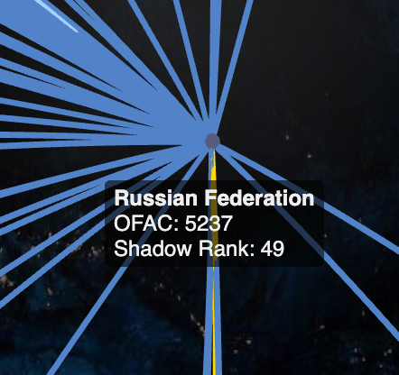
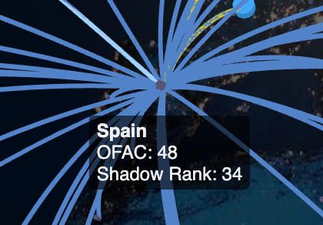
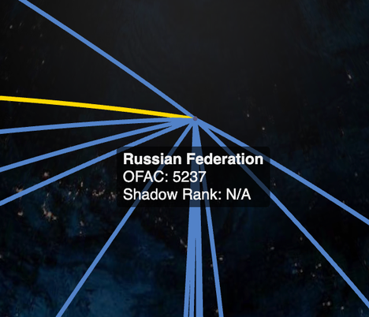
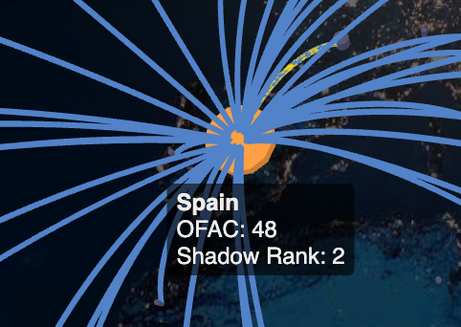
Network Analysis
Massive global economies break standard network anomaly models
1
2022 Sanctions shattered direct trade, forcing complex European reroutes
After 2022 sanctions
2
Emerging hubs: highest change in residual shadow (From 2021 to 2024)
3

Slide 9
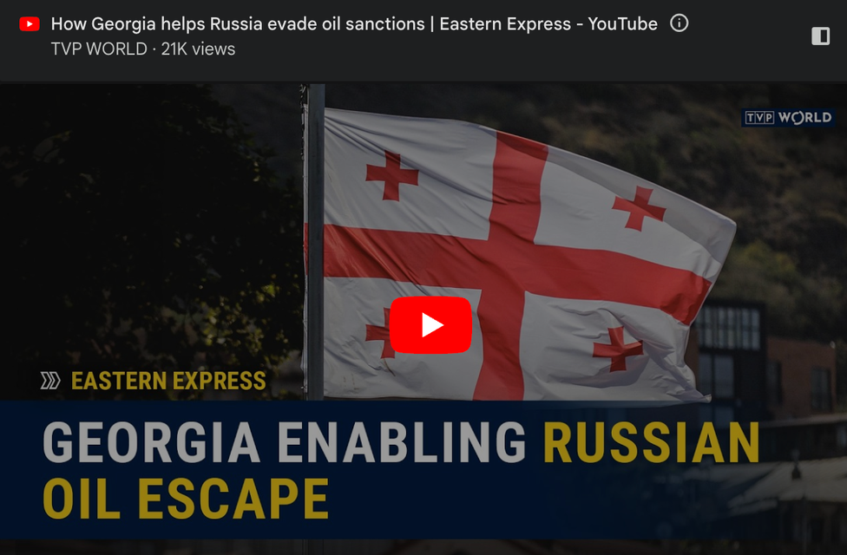
GEORGIA- the laundering syndicate
Validated by a recent investigative journalism!
#1 Highest Weighted Clustering Score globally based on 2024 data
1
The Oil "Washing Machine" Effect
2
Disguise sanctioned Russian crude as a clean "Caspian blend."
3
https://youtu.be/CwIZ8aACRSo

Slide 10

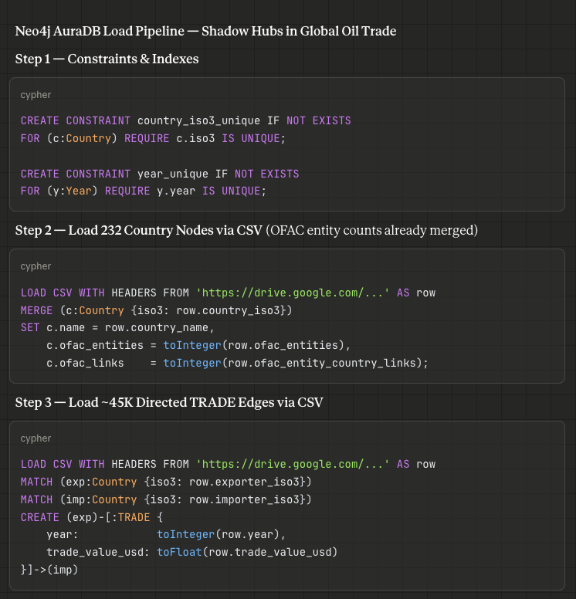
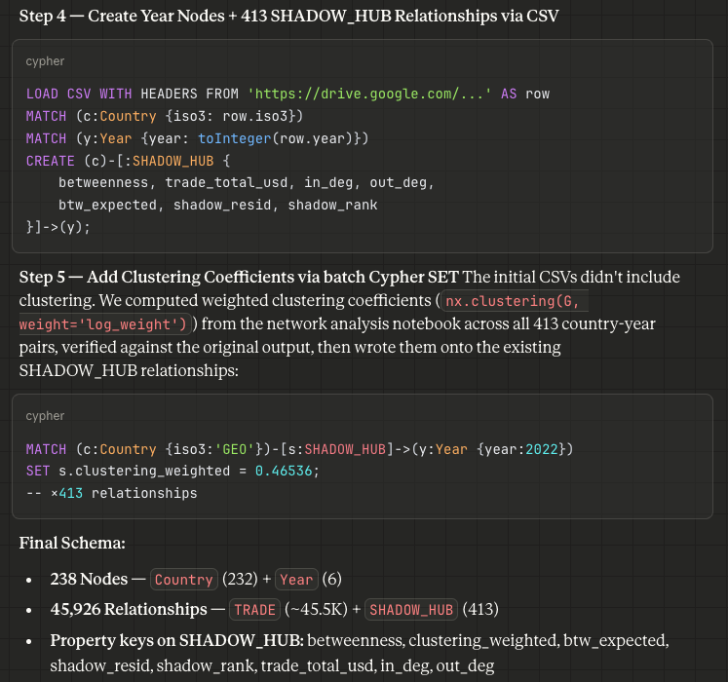
From Tables to a Graph DB
Notes:
Schema Design — We modeled countries, years, trade flows, and shadow hub scores as a connected graph in Neo4j AuraDB. Each Country node links to Year nodes through SHADOW_HUB relationships carrying betweenness, clustering coefficients, residual, and ranking properties.
Cypher-Powered Queries — Neo4j's query language lets us ask structural questions natively: find top shadow hubs across all years, track how a country's rank shifted post-2022, or surface sanctioned-country trade trends.
Live Cloud Access — The graph runs on AuraDB, giving our API and AI pipeline direct read access to the full trade network without managing infrastructure.

Slide 11
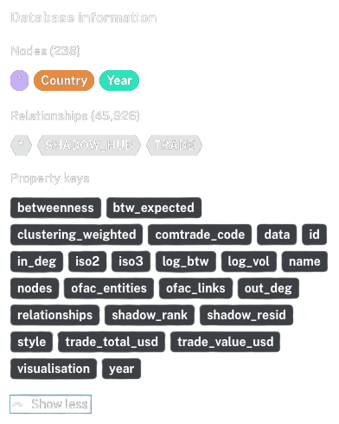
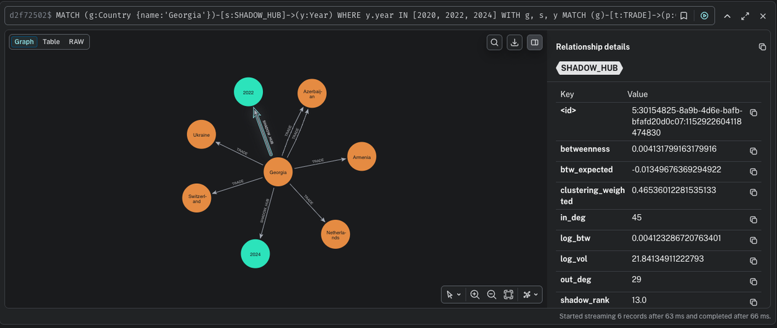
Neo4j Schema
Notes:
Schema Design — We modeled countries, years, trade flows, and shadow hub scores as a connected graph in Neo4j AuraDB. Each Country node links to Year nodes through SHADOW_HUB relationships carrying betweenness, clustering coefficients, residual, and ranking properties.
Cypher-Powered Queries — Neo4j's query language lets us ask structural questions natively: find top shadow hubs across all years, track how a country's rank shifted post-2022, or surface sanctioned-country trade trends.
Live Cloud Access — The graph runs on AuraDB, giving our API and AI pipeline direct read access to the full trade network without managing infrastructure.

Slide 12



GraphRAG Pipeline
Plan
Retrieve & Draft
Evaluate & Refine
LangGraph state machine orchestrates the pipeline
Intent Classification (7 types)
Country / Year / top-N extraction + ambiguity resolution
Meta & general questions routed to embedded project reference
Cypher Queries + vector similarity search (hybrid retrieval)
GPT-4o drafts cited answer with [C#] / [V#] inline citations
General questions use embedded project reference instead of graph evidence
Rule-based + LLM quality checks on draft
Finalize / rewrite & loop (up to 2x) / ask for clarification
Meta questions skip strict citation requirements
Notes:
Plan:
Classifies each question into 1 of 7 intent types (hub_partners, top_shadow_hubs, sanctioned_shadow_trend, general, etc.)
Extracts country ISO codes, year filters, and top-N parameters; resolves ambiguous country names
Routes meta/general questions to an embedded project reference covering methodology, tech stack, and data sources
Retrieve & Draft:
Runs intent-specific Cypher queries against Neo4j + vector similarity search over embedded concept definitions
OpenAI GPT-4o drafts a cited answer with inline [C#] and [V#] citations referencing graph and vector evidence
General questions draw on the embedded project reference instead of requiring graph evidence
Evaluate & Refine:
Rule-based checks (citations present? country mentioned? evidence empty?) plus LLM evaluation score the draft
Three exit paths: finalize if quality passes, rewrite query and loop back to Plan (up to 2 retries), or ask user for clarification
General/meta questions bypass strict citation checks since they don't need graph evidence

Slide 13
GraphRAG - Key Improvements
Query Understanding
Answer Reliability
Retrieval Enhancements
Added detection for highest betweenness queries
Better handling of ambiguous or incomplete queries
Added support for cross-year questions (e.g., highest residual across all years)
Reduced hallucination by forcing evidence-grounded answers
Improved evaluation stage to catch weak or unsupported answers
Strengthened rules for interpreting shadow hub metrics
Strengthened graph-first retrieval, ensuring exact Neo4j metrics are used before vector-based evidence
Added specialized Cypher queries for network centrality metrics and shadow hub ranking

Slide 14
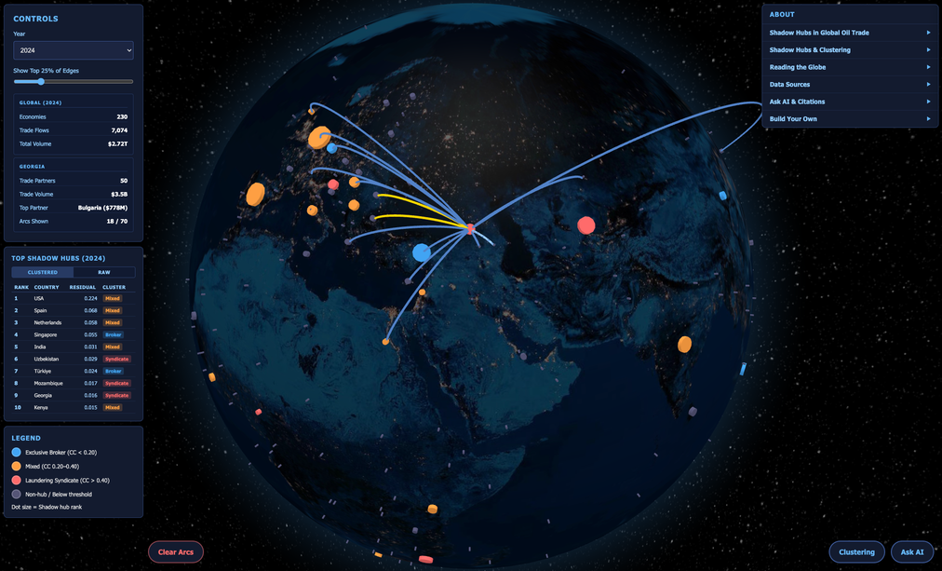
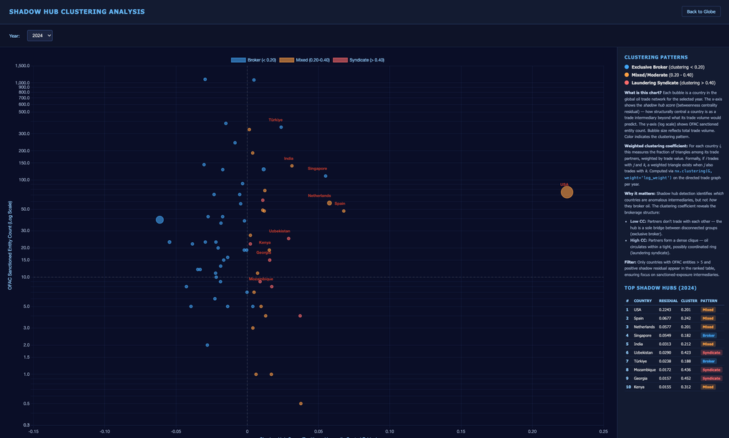
Interactive Globe
Globe.gl + WebGL 3D globe where every country is a clickable point
1
Detailed annual clustering visualizations on alternate view
2
GraphRAG “Ask AI” built in: Python API backend connects the globe to the LangGraph Pipeline and Neo4j
3
One-Stop Insights Resource
Notes:
Globe.gl + WebGL — A 3D rendered globe where every country is a clickable point, sized by shadow hub score and colored by clustering pattern: Exclusive Brokers, Mixed, or Laundering Syndicates.
Year Dropdown + Leaderboard — Select any year from 2019–2024 to watch trade arcs and rankings restructure in real time. The leaderboard toggles between clustered and raw views of the top shadow hubs.
AI Chat Built In — The GraphRAG pipeline is embedded directly in the tool. Click a country, then ask follow-up questions in natural language without leaving the page.

Slide 15
Caveats and Next Steps
Limitations
Shadow hubs flag structural anomalies, not definitive sanctions evasion
High residual = more central than trade volume predicts
Clustering adds a second lens: "Brokers" bridge disconnected groups, "Syndicates" operate in tight trading blocs
Legitimate explanations exist: geography, refining capacity, trade agreements
This is a screening tool: where to look, not what you'll find
Future Data Layers
The current model shows where to look. Adding ground-truth data would show who is actually doing it:
Beneficial ownership data to trace who controls entities behind anomalous flows
Vessel tracking (AIS) to flag dark voyages and ship-to-ship transfers
Entity-level sanctions matching against SDN, EU, and UN lists
Financial flow data (SWIFT) to verify money flows match physical trade

Slide 16
Thank You
Explore the project and try it yourself at the links below
Shadow Hubs Globe
GitHub

